Slide 1
Debunking the Doctrine of Discovery:
Colonial excuse for the seizure of lands and oppression of peoples
By
Tl’ul’thut Robert Morales
Hul’qumi’num Treaty Group

Slide 2
Doctrine of discovery
Without question, the Doctrine’s most important principle, its central animating idea, is the principle of extinguishment. Williams

Slide 3
Extinguishment
This Doctrine of Extinguishment will typically originate in a language of racism and religious and cultural intolerance which regards indigenous peoples as savage, backwards, and inferior, and therefore an obstacle to the progress and development of a superior form of civilization, the non-indigenous nation-state. Williams

Slide 4
Under this principle, the colonizing State asserts the power to extinguish indigenous peoples’ property rights in their traditional lands and their rights to self-determination in those lands. Under the Doctrine, the State also has the power, in essence, to extinguish our languages and religions, and even our existence by recognizing some, and not recognizing other indigenous peoples as being indigenous. The State, under this power of extinguishment, can even terminate that very act of recognition if it so desires with impunity. Williams

Slide 5
What has impacted and continues to impact Indigenous nations and peoples is not so much the idea of “discovery,” but the centuries of treating the domination and dehumanization of originally free nations and peoples as legitimate.
The Doctrine of Christian Discovery and Domination refers to patterns of thought and dogma used to legitimize the domination of originally free and independent nations and peoples. Williams

Slide 6
Foundation for European nations policy of denial and beginning of international law
In 1095, at the beginning of the Crusades, Pope Urban II issued an edict-the Papal Bull Terra Nullius (meaning empty land). It gave the kings and princes of Europe the right to "discover" or claim land in non-Christian areas.
The New World, on paper, was legally "vacant"--terra nullius or vacuum domicilium in Latin.

Slide 7
"We grant you [Kings of Spain and Portugal] by these present documents, with our Apostolic Authority, full and free permission to invade, search out, capture, and subjugate the Saracens and pagans and any other unbelievers and enemies of Christ wherever they may be, as well as their kingdoms, duchies, counties, principalities, and other property [...] and to reduce their persons into perpetual slavery. ”

Slide 8
This policy was extended in 1452 when Pope Nicholas V issued the bull Romanus Pontifex, declaring war against all non-Christians throughout the world and authorizing the conquest of their nations and territories.
These edicts treated non-Christians as uncivilized and subhuman, and therefore without rights to any land or nation. Christian leaders claimed a God-given right to take control of all lands and used this idea to justify war, colonization, and even slavery.

Slide 9
By the time Christopher Columbus set sail in 1492, this Doctrine of Discovery was a well-established idea in the Christian world. When he reached the Americas, Columbus performed a ceremony to "take possession" of all lands "discovered," meaning all territory not occupied by Christians.

Slide 10
Upon his return to Europe in 1493, Pope Alexander VI issued the bull Inter Cetera, granting Spain the right to conquer the lands that Columbus had already "discovered" and all lands that it might come upon in the future.
** This decree also expressed the Pope's wish to convert the natives of these lands to Catholicism in order to strengthen the "Christian Empire."

Slide 11
16th Century Era attitudes
The Valladolid Controversy was organized by King Charles V (grandson of Ferdinand and Isabella) to give an answer to the question whether the Native Americans were capable of self-governance and capable of ownership of property.

Slide 12
The Controversy is set in the year 1550, a half-century into the Spanish conquest of the New World. In a monastery in the Spanish city of Valladolid, three priests and a philosopher meet to resolve a thorny issue: do the native of the Americas have souls, and should they be treated with the same respect as Europeans?
Sepúlveda on one side
Las Casas and de Vitoria on other side

Slide 13
Sepúlveda reasoned, the Indians were a barbarian race whose natural, inferior condition entitled the Spaniards to wage war on them. As Sepúlveda put it, “being slaves by nature, [the Indians], uncivilized, barbarian and inhuman, refuse to accept the rule of those civilized [the Spaniards] and with much more power than them.”

Slide 14
Other side of argument
Las Casas: Long before the Indians heard the word "Spaniard", they had properly organized states, states wisely ordered by excellent laws, religion and custom. They cultivated friendships, came together in common fellowship, lived in populous cities. In fact, they were governed by laws that surpass our own at many points.

Slide 15
Francisco de Vitoria introduced the topic of indigenous peoples‘ rights into the dialogue of international law in his 1532 lecture, "On the Indians Lately Discovered."'' Central to Vitoria's philosophy, was that "certain basic rights inhere in men as men . ..by reason of their humanity.' Vitoria's views on Indian rights were subsequently embraced by the papacy and the Spanish Crown.

Slide 16
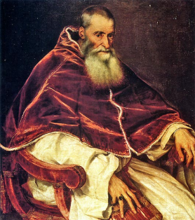
Pope Paul III on June 2, 1537
In Sublimis Deus, Paul III unequivocally declares the indigenous peoples of the Americas to be rational beings with souls. Its principles eventually became the official position of Charles V, Holy Roman Emperor and King of Spain, although it was often ignored by the colonists and conquistadores themselves

Slide 17
Extinguishment by Judicial decisions and political positions

Slide 18
Johnson v. McIntosh- establishing of domestic law leaning to denial policy
In Chief Justice Marshall's words: [T]he character and religion of [the New World's] inhabitants afforded an apology for considering them as a people over whom the superior genius of Europe might claim an ascendancy. To leave them in possession of their country was to leave the country a wilderness. [A]griculturalists, merchants, and manufacturers, have a right, on abstract principles, to expel hunters from [their] territory .... [E]xcuse, if not justification, [could be found] in the character and habits of the people whose rights ha[d] been wrested from them. The potentates of the Old World ... made ample compensation to the inhabitants of the new, by bestowing upon them civilization and Christianity. ....

Slide 19
Importantly, the recognition of Indian ownership led Vitoria to conclude that Europeans could not acquire title to Indian lands by mere "discovery," since the Doctrine of Discovery only applied to lands that belonged to "nobody":
Yet in Johnson, Marshall disregarded the principles announced by Vitoria, and applied the Doctrine of Discovery as if the Indians were "nobody," under Vitoria's thesis.

Slide 20
By denying the Indians' ownership rights in their lands and reducing their status from "true owners" to "occupants," Marshall disregarded accepted principles of the Law of Nations.
Marshall further deviated from the Law of Nations in his treatment of title by conquest and the obligations of successive sovereigns to the conquered. ' Marshall recognized that under the general rule, the conquered should be incorporated into the conqueror's society and "the rights of the conquered to property should remain unimpaired .. ,

Slide 21
The real conquest was on paper, on maps and in laws. What those maps showed and those laws said was that Indians had been "conquered" merely by being "discovered." As put by Supreme Court Chief Justice John Marshall in the case of Johnson v. McIntosh,2 "[h]owever extravagant the pretention of converting the discovery of an inhabited country into conquest may appear, if the principle has been asserted in the first instance ... if a country has been acquired and held under it; .. .it becomes the law of the land, and cannot be questioned."

Slide 22
Canada courts adopt Johnson beginning with St Catherine’s Milling
According to the Chancellor, Indians at the time of discovery were nomadic "heathens and barbarians" who lacked "any proprietary title to the soil . . . . In support of this view, Boyd cited a 1675 legal opinion in which eminent English lawyers declared that the discovery of barbarian lands gave the discovering nation the "Right of Soyle & Govermt of place. . . ." Boyd then asserted that in Johnson v. McIntosh, Chief Justice Marshall "has concisely stated the same law of the mother country, which the United States inherited, and applied with such modifications as were necessitated by the change of government to their dealings with the Indians."

Slide 23
St Catherine Milling- Judicial
Committee of the Privy Council
Lord Watson, on behalf of the Council, rejected the notion that the Ojibway had been "the owners in fee simple of the territory which they surrendered" and instead held that the Crown "has all along had a present proprietary estate in the land, upon which the Indian title was a mere burden." Rather than constituting an ownership right, "the tenure of the Indians was a personal and usufructuary right, dependent upon the good will of the Sovereign.”

Slide 24
R. v. Syliboy (1929)
1 D.L.R. 307 (Canada)
“…But the Indians were never regarded as an independent power. A civilized nation first discovering a country of uncivilized people or savages held such country as its own until such time as by treaty it was transferred to some other civilized nation. The savages’ rights of sovereignty, even of ownership, were not recognized. Nova Scotia had passed to Great Britain not by gift or purchase or even by conquest of the Indians but by treaty with France, which had acquired it by priority of discovery and ancient possession, and the Indians passed with it….”

Slide 25
Canada’s Defense in Mikmaq Tribal Society v. Canada
UN Human Rights Committee (1980)
“International, American and Canadian law do not recognize treaties with North American Native People as international documents confirming the existence of these tribal societies as independent and sovereign states. These treaties are merely considered to be nothing more than contracts between a sovereign and a group of its subjects”

Slide 26
Calder
[T]hat on discovery or on conquest the aborigines of newly-found lands were conceded to be the rightful occupants of the soil, with a legal as well as a just claim to retain possession of it and to use it according to their own discretion, but their rights to complete sovereignty as independent nations were necessarily diminished and their power to dispose of the soil on their own will to whomsoever they pleased was denied by the original fundamental principle that discovery or conquest gave exclusive title to those who made it

Slide 27
Sparrow SCC
It is worth recalling that while British policy towards the native population was based on respect for their right to occupy their traditional lands, a proposition to which the Royal Proclamation of 1763 bears witness, there was from the outset never any doubt that sovereignty and legislative power, and indeed the underlying title, to such lands vested in the Crown; see Johnson v. M'Intosh

Slide 28
Delgamuukw SCC
This review of the general principles underlying the issue of aboriginal title to land brings us to the specific requirements for title set out in Delgamuukw. To establish title, claimants must prove "exclusive" pre-sovereignty "occupation" of the land by their forebears: per Lamer C.J., at para. 143.
Canadian courts have applied Marshall’s “discovery” theory in support of the Crown’s ultimate title to the land but have neglected Marshall’s finding that aboriginal peoples retained a form of internal sovereignty.

Slide 29
Tsilhqot’in decision BCCA 2011
The basic concepts underlying claims of Aboriginal title and Aboriginal rights are straightforward. First Nations occupied the land that became Canada long before the arrival of Europeans. As the trial judge noted at para. 592, “Aboriginal nations were not recognized as nation states by the European nations colonizing North America”. European explorers considered that by virtue of the “principle of discovery” they were at liberty to claim territory in North America on behalf of their sovereigns (see Guerin v. The Queen, [1984] 2 S.C.R. 335 at 378). While it is difficult to rationalize that view from a modern perspective, the history is clear. As was said in Sparrow at 1103:
[W]hile British policy towards the native population was based on respect for their right to occupy their traditional lands, … there was from the outset never any doubt that sovereignty and legislative power, and indeed the underlying title, to such lands vested in the Crown. [Citations omitted.]

Slide 30
There is a need to search out a practical compromise that can protect the aboriginal traditions without unnecessarily interfering with Crown sovereignty and the well being of all Canadians. As I see it, an overly-broad recognition of Aboriginal title is not conducive to these goals.

Slide 31
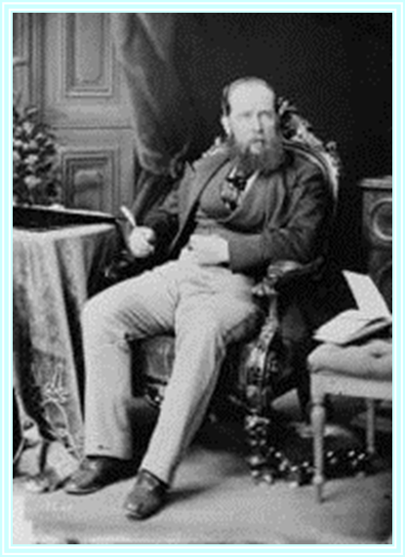

The 19th Century Colonial Era
“I think they are the ugliest and laziest creatures I ever saw, and we should, as soon think of being afraid of our dogs as of them.”
Letter from Joseph Trutch to his wife Charlotte Trutch, expressing his views on the Indians of the Oregon Territory, 23 June 1850 (Trutch Papers)
“The Indians really have no right to the lands they claim, nor are they of any actual value or utility to them; I cannot see why they should either retain these lands to the prejudice of the general interests of the Colony, or be allowed to make a market of them either to Government or to individuals.”
Joseph Trutch, Commissioner of Land Works for the colonial government in British Columbia, 1867

Slide 32


At the G20 conference 2009, Stephen Harper claims Canada has “no history of colonialism”

Slide 33
Mabo
The idea that land which is in regular occupation may be terra nullius is unacceptable, in law as well as in fact. Even the proposition that land which is not in regular occupation may be terra nullius is one that demands scrutiny; there may be good reason why occupation is irregular.
The theory that the indigenous inhabitants of a "settled" colony had no proprietary interest in the land thus depended on a discriminatory denigration of indigenous inhabitants, their social organization and customs. As the basis of the theory is false in fact and unacceptable in our society, there is a choice of legal principle to be made …

Slide 34
The fiction by which the rights and interests of indigenous inhabitants in land were treated as non existent was justified by a policy which has no place in the contemporary law of this country. The expectations of the international community accord in this respect with the contemporary values of the Australian people.

Slide 35
Canada’s Original Position on the UN Declaration
"...Canada's position has remained consistent and principled. We have stated publicly that we have significant concerns with respect to the wording of the current text, including the provisions on lands, territories and resources; free, prior and informed consent when used as a veto; self-government without recognition of the importance of negotiations; intellectual property; military issues; and the need to achieve an appropriate balance between the rights and obligations of indigenous peoples, member States and third parties.”
Statement by Ambassador McNee to the General Assembly on the Declaration on the Rights of Indigenous Peoples, 13 September 2007.

Slide 36
Indigenous Human Rights Era
Based on recognition
Reisman opines that the original phase of "[d]ecolonization was really a demand for law and human rights;,, in short, it was a call for universal emancipation of the colonized.

Slide 37
The Case of Awas Tingni vs. Nicaragua
Decision of the Inter-American Court
Nicaragua violated the right to an effective remedy (articles 25, together with articles 1 and 2) by failing to ensure enjoyment of the indigenous land rights that are affirmed in the Nicaraguan Constitution and Laws.
Nicaragua violated the right to property (article 21) by granting concessions to exploit the resources on Awas Tingni traditional lands and by not titling and demarcating those lands in favor of the community. The right to property includes the collective right of indigenous peoples to the enjoyment of their traditional lands and natural resources.
“…For indigenous communities, relations to the land are not merely a matter of possession and production but a material and spiritual element which they must fully enjoy, even to preserve their cultural legacy and transmit it to future generations.”

Slide 38
The Case of Dann vs. the United States
Decision of the Inter-American Commission
“Where property and user rights of indigenous peoples arise from rights existing prior to the creation of a state, [indigenous peoples have the right to] recognition by that state of the permanent and inalienable title of indigenous peoples relative thereto and to have such title changed only by mutual consent between the state and respective indigenous peoples when they have full knowledge and appreciation of the nature or attributes of such property. This also implies the right to fair compensation in the event that such property and user rights are irrevocably lost.”

Slide 39
The Case of the Maya Indigenous Communities of the Toledo District vs. Belize
The Obligations of the State under Article XXIII
131. Accompanying the existence of the Maya people’s communal right to property under Article XXIII is a correspondent obligation on the State to recognize and guarantee the enjoyment of this right. In this regard, the Commission shares the view of the Inter-American Court of Human Rights that this obligation necessarily requires the State to effectively delimit and demarcate the territory to which the Maya people’s property right extends and to take the appropriate measures to protect the right of the Maya people in their territory, including official recognition of that right. In the Commission’s view, this necessarily includes engaging in effective and informed consultations with the Maya people concerning the boundaries of their territory, and that the traditional land use practices and customary land tenure system be taken into account in this process.

Slide 40
Case of the Saramaka People v. Suriname November 28, 2007
105. The Court observes that although so-called judge-made law may certainly be a means for the recognition of the rights of individuals, particularly under common-law legal systems, the availability of such a procedure does not, in and of itself, comply with the State’s obligation to give legal effect to the rights recognized in the American Convention. That is, the mere possibility of recognition of rights through a certain judicial process is no substitute for the actual recognition of such rights. In any case, the right of the members of the Saramaka people in particular, or members of indigenous and tribal communities in general, to collectively own their territory has not, as of yet, been recognized by any domestic court in Suriname.

Slide 41
Case of the Sawhoyamaxa Indigenous Community v. Paraguay
The following conclusions are drawn from the foregoing: 1) traditional possession of their lands by indigenous people has equivalent effects to those of a state-granted full property title;
2) traditional possession entitles indigenous people to demand official recognition and registration of property title;
3) the members of indigenous peoples who have unwillingly left their traditional lands, or lost possession thereof, maintain property rights thereto, even though they lack legal title, unless the lands have been lawfully transferred to third parties in good faith; and

Slide 42
Cont.
4) the members of indigenous peoples who have unwillingly lost possession of their lands, when those lands have been lawfully transferred to innocent third parties, are entitled to restitution thereof or to obtain other lands of equal extension and quality. Consequently, possession is not a requisite conditioning the existence of indigenous land restitution rights.

Slide 43
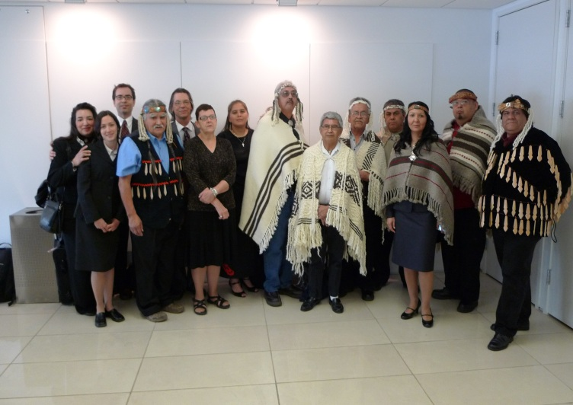
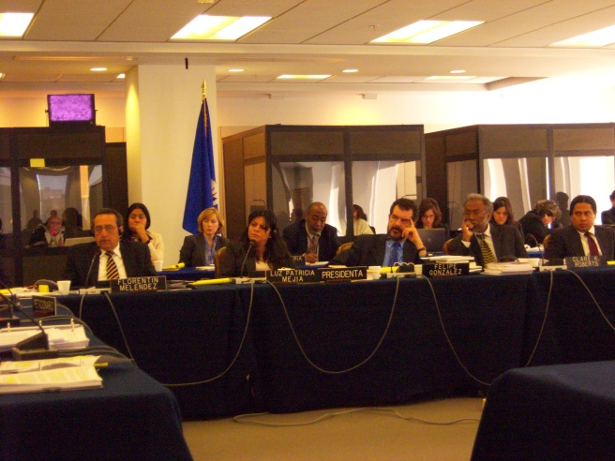
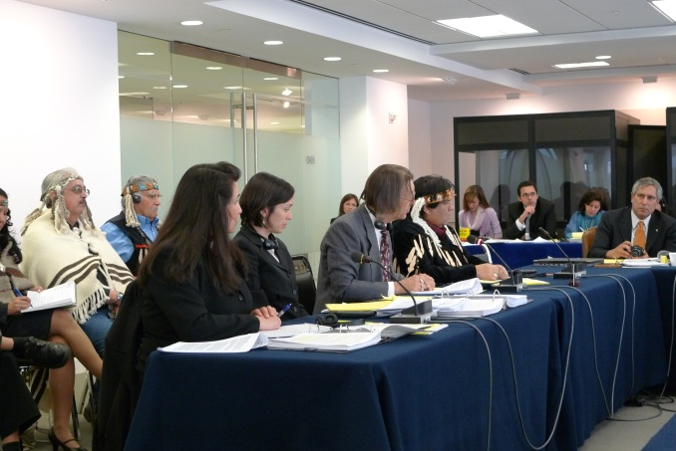
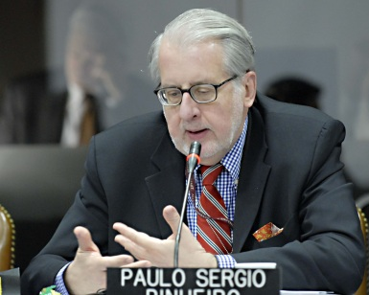
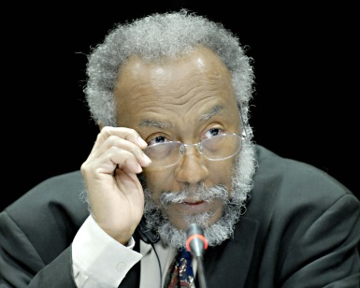

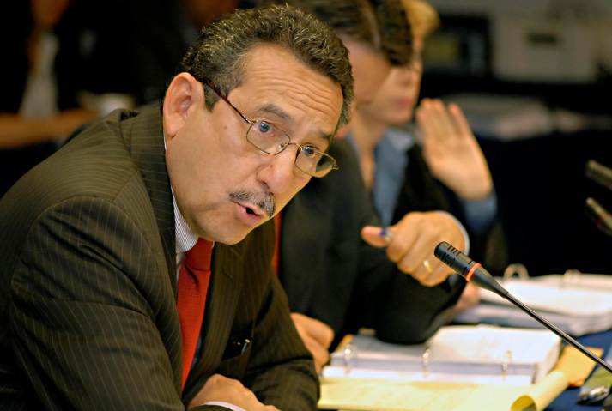
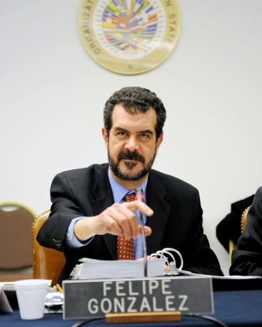
International Human Rights in Protection of Indigenous Peoples Rights
Hul’qumi’num Nations
Petition to IACHR

Slide 44
Hul’qumi’num Treaty Group v. Canada
The State’s unequivocal position is that private land is not on the table in the BCTC process. BC held a referendum, which BC says is still their position and mandate, stating that private lands are not included in the BCTC process. Canada has clearly said that compensation is not on the table in their Comprehensive Claims policy.
The result of these two positions is that these lands are not on the table, either for return or fair compensation, except on the so called “willing seller willing buyer” basis.

Slide 45
Admissibility ruling
In this ruling, the IACHR found that “by failing to resolve the HTG claims with regard to their ancestral lands, the BCTC process has demonstrated that it is not an effective mechanism to protect the right [to property] alleged by the alleged victims”. Indeed, examining the government’s position that if a First Nation does not wish to accept its terms negotiating, that it can litigate, the IACHR noted that “there is no due process of law to protect the property rights of the HTG to its ancestral lands”

Slide 46
Admissibility ruling
The IACHR observed that “the legal proceedings mentioned above [the Canadian court cases on aboriginal title] do not seem to provide any reasonable expectations of success, because Canadian jurisprudence has not obligated the State to set boundaries, demarcate, and record title deeds to lands of indigenous peoples, and, therefore, in the case of HTG, those remedies would not be effective under recognized general principles of international law.”

Slide 47
The 20th Century Indigenous Human Rights Era
UN Committee on the Elimination of Racial Discrimination General Recommendation No. 23 on Indigenous Peoples
(1997)
“In many regions of the world indigenous peoples have been, and are still being, discriminated against and deprived of their human rights and fundamental freedoms … they have lost their land and resources to colonists, commercial companies and State enterprises. Consequently, the preservation of their culture and their historical identity has been and still is jeopardized.”

Slide 48
The 20th Century Indigenous Human Rights Era
UN HUMAN RIGHTS COMMITTEE
Comments on Canada (1999)
“The Human Rights Committee recommended that Canada reform its laws and internal policies to guarantee the full enjoyment of rights over land and resources for the indigenous people of Canada. Additionally, the Committee recommended that Canada abandon “the practice of extinguishing inherent aboriginal rights … as incompatible with article 1 of the Covenant. “

Slide 49
The 21st Century Indigenous Rights Era
UN Committee on Economic, Social and Cultural Rights
Concluding Observations: Canada (May 22, 2006), at para. 16.
“The Committee, while noting that the State party has withdrawn, since 1998, the requirement for an express reference to extinguishment of Aboriginal rights and titles either in a comprehensive claim agreement or in the settlement legislation ratifying the agreement, remains concerned that the new approaches, namely the “modified rights model” and the “non-assertion model”, do not differ much from the extinguishment and surrender approach.”

Slide 50
United Nations Declaration on the Rights of Indigenous Peoples
Article 27
States shall establish and implement, in conjunction with indigenous peoples concerned, a fair, independent, impartial, open and transparent process, giving due recognition to indigenous peoples’ laws, traditions, customs and land tenure systems, to recognize and adjudicate the rights of indigenous peoples pertaining to their lands, territories and resources, including those which were traditionally owned or otherwise occupied or used. Indigenous peoples shall have the right to participate in this process. Article 28
Indigenous peoples have the right to redress, by means that can include restitution or, when this is not possible, of a just, fair and equitable compensation, for the lands, territories and resources which they have traditionally owned or otherwise occupied or used, and which have been confiscated, taken, occupied, used or damaged without their free, prior and informed consent.

Slide 51
Report of the UN Special Rapporteur on the situation of the human rights and fundamental freedoms of indigenous peoples, S. James Anaya (2008)
“Accordingly, the Declaration does not attempt to bestow indigenous peoples with a set of special or new human rights, but rather provides a contextualized elaboration of general human rights principles and rights as they relate to the specific historical, cultural and social circumstances of indigenous peoples. …From this perspective, the standards of the Declaration connect to existing State obligations under other human rights instruments.”

Slide 52
Indigenous Human Rights under International Law
International system
  United Nations
    General Human Rights
    Declaration on the Rights of Indigenous Rights
  Organization of American States
    OAS Charter
    American Declaration on the Rights and Duties of Man

Slide 53
Sources of International Law
Hard law – binding on States:
  Treaties/covenants/conventions – countries must take steps to sign/ratify
  Customary international law – applies to all countries
Soft law – not directly binding on their own:
  General assembly resolutions
  Declarations
  Reports/comments of UN committees

Slide 54
Full and effective implementation of the Declaration will extinguish the ability of governments to extinguish us- Williams

